Slide 1
Microsoft Teams Developer
Using Cards in Microsoft Teams

Slide 2

Using Cards in Microsoft Teams
Using Cards in Bots
Using Cards in Messaging Extensions
Adaptive Cards support in Microsoft Teams
DEMO

Slide 3
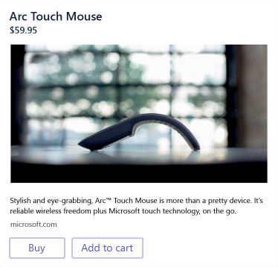
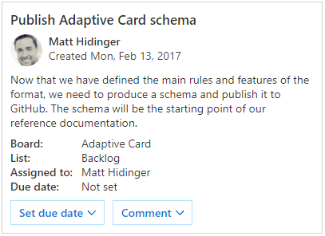
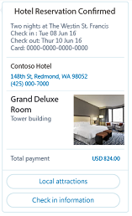
Using Cards in Bots
Adaptive Card
A customizable card that can contain any combination of text, speech, images, buttons, and input fields.
Supported in Teams, Outlook, Windows, etc.
Hero
Largest card
Best used for articles, long descriptions or scenarios where your image is telling most of the story
Receipt
A card that enables a bot to provide a receipt to the user. It typically contains the list of items to include on the receipt, tax and total information, and other text.
Notes:
This is a sample of cards that can be used. Refer to https://docs.microsoft.com/en-us/microsoftteams/platform/concepts/cards/cards-reference for details

Slide 4
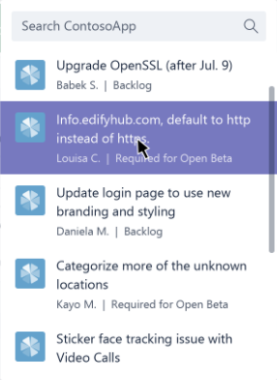
Using Cards in Messaging Extensions
Respond with attachment layout of “List”
Format each query result as a card
Adaptive Card
Hero Card
Thumbnail Card
O365Connector Card
Do not include actions

Slide 5
Adaptive Cards support in Microsoft Teams
Microsoft Teams supports three action types for Adaptive cards:
Action.OpenUrl
Action.Submit
Action.ShowCard
Actions other than these are not supported

Slide 6
Demo Adaptive Cards in Microsoft Teams

Slide 7

Summary
Using Cards in Bots
Using Cards in Messaging Extensions
Adaptive Cards support in Microsoft Teams

Slide 8
Thank you

